Slide 1
CS3006 Parallel and Distributed Computing
Fall 2022
National University of Computer and Emerging Sciences

Slide 2
Chapter 6. Programming Using the Message Passing Paradigm

Slide 3
Recall…
A message-passing platform consists of p processing nodes, each with its own exclusive address space.
Interactions between processes running on different nodes must be accomplished using messages (data, work, and to synchronize actions among the processes), hence the name message passing.
The basic operations in this programming paradigm are send and receive.
The message-passing programming paradigm is one of the oldest and most widely used approaches for programming parallel computers.

Slide 4
Principles of Message-Passing Programming
The two key attributes to characterize the message-passing programming paradigm.
The first is that it assumes a partitioned address space
Second is that it supports only explicit parallelization.
There are two immediate implications of a partitioned address space.
First, each data element must belong to one of the partitions of the space; hence, data must be explicitly partitioned and placed.
The second implication is that all interactions (read-only or read/write) require cooperation of two processes - the process that has the data and the process that wants to access the data

Slide 5
Principles of Message-Passing Programming
Message-passing programs are often written using the asynchronous or loosely synchronous paradigms
In the asynchronous paradigm, all concurrent tasks execute asynchronously.
However, such programs can be harder to reason about, and can have nondeterministic behavior due to race conditions .
In the loosely synchronous model, tasks or subsets of tasks synchronize to perform interactions. Between these interactions, tasks execute completely asynchronously.
Most message-passing programs are written using the single program multiple data (SPMD) model.
Notes:
The message-passing programming paradigm requires that the parallelism is coded explicitly by the programmer.
In its most general form, the message-passing paradigm supports execution of a different program on each of the p processes. This provides the ultimate flexibility in parallel programming, but makes the job of writing parallel programs effectively unscalable.
In SPMD programs the code executed by different processes is identical except for a small number of processes (e.g., the "root" process)

Slide 6
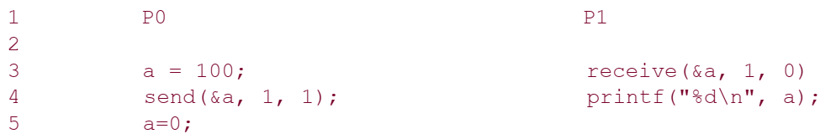
The Building Blocks: Send and Receive Operations
In their simplest form, the prototypes of these operations are defined as follows:
send(void *sendbuf, int nelems, int dest)
receive(void *recvbuf, int nelems, int source)
Notes:
The semantics of the send operation require that the value received by process P1 must be 100 as opposed to 0.
This motivates the design of the send and receive protocols.

Slide 7
Modes of Communication
Point-to-point communication
Blocking – returns from call when task completes
Nonblocking – returns from call without waiting for task to complete
Collective communication

Slide 8
The semantics of the send operation require that the value received by process P1 must be 100 as opposed to 0.
This motivates the design of the send and receive protocols.

Slide 9
Blocking Message Passing Operations
A simple method for forcing send/receive semantics is for the send operation to return only when it is safe to do so.
In the non-buffered blocking send, the operation does not return until the matching receive has been encountered at the receiving process.
Idling and deadlocks are major issues with non-buffered blocking sends.

Slide 10
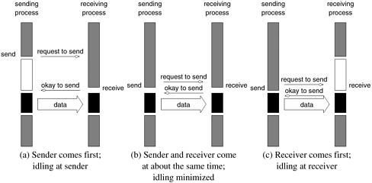
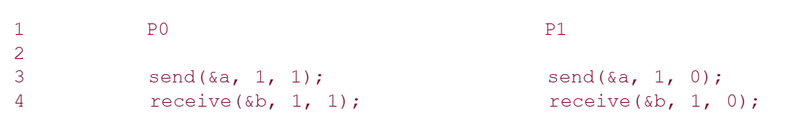

Slide 11
In buffered blocking sends, the sender simply copies the data into the designated buffer and returns after the copy operation has been completed.
The data is copied at a buffer at the receiving end as well.
Buffering alleviates idling at the expense of copying overheads.

Slide 12
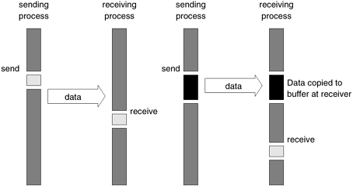
Blocking buffered transfer protocols: (a) in the presence of communication hardware with buffers at send and receive ends; and (b) in the absence of communication hardware, sender interrupts receiver and deposits data in buffer at receiver end.

Slide 13
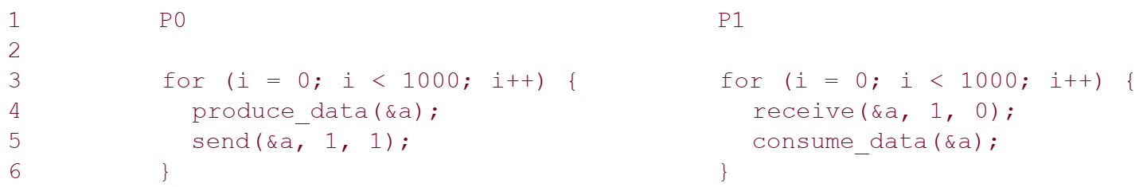
What if consumer was much slower than producer?
This can often lead to unforeseen overheads and performance degradation.

Slide 14
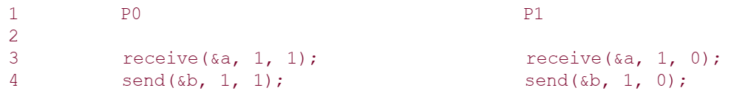
Deadlocks are still possible with buffering since receive operations block.

Slide 15
Non-Blocking Message Passing Operations
This class of non-blocking protocols returns from the send or receive operation before it is semantically safe to do so.
Non-blocking operations are generally accompanied by a check-status operation.
When used correctly, these primitives are capable of overlapping communication overheads with useful computations.
Message passing libraries typically provide both blocking and non-blocking primitives.

Slide 16
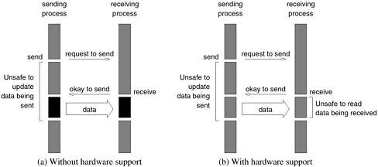

Slide 17
Collective Communication and Computation Operations
All of the collective communication functions provided by MPI take a communicator as an argument that defines the group of processes that participate in the collective operation.

Slide 18
Collective Communication and Computation Operations : Barrier
The barrier synchronization operation is performed in MPI using the MPI_Barrier function.
int MPI_Barrier(MPI_Comm comm)
The only argument of MPI_Barrier is the communicator that defines the group of processes that are synchronized.
The name of the function is quite descriptive - the function forms a barrier, and no processes in the communicator can pass the barrier until all of them call the function.

Slide 19
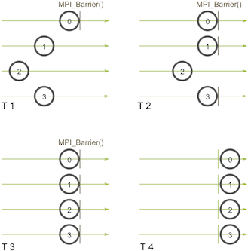

Slide 20
One-to-All Broadcast
Parallel algorithms often require a single process to send identical data to all other processes or to a subset of them. This operation is known as one-to-all broadcast.
Initially, only the source process has the data of size m that needs to be broadcast.
At the termination of the procedure, there are p copies of the initial data – one belonging to each process.
One of the main uses of broadcasting is to send out user input to a parallel program, or send out configuration parameters to all processes.

Slide 21
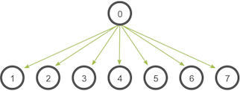

Slide 22
One-to-All Broadcast
The one-to-all broadcast operation is performed in MPI using the MPI_Bcast function
int MPI_Bcast(void *buf, int count, MPI_Datatype datatype, int source, MPI_Comm comm)
MPI_BCAST operation sends data from one member of one group to all members of the other group
MPI_Bcast sends the data stored in the buffer buf of process source to all the other processes in the group

Slide 23
One-to-All Broadcast
The data received by each process is stored in the buffer buf.
The data that is broadcast consist of count entries of type datatype.
Although the source process and receiver processes do different jobs, they all call the same MPI_Bcast function.
When the source process calls MPI_Bcast, the buffer data will be sent to all other processes.
When all of the receiver processes call MPI_Bcast, the buffer data will be filled in with the data from the root process.

Slide 24
All-to-One Reduction
Reduce is a classic concept from functional programming.
Data reduction involves reducing a set of numbers into a smaller set of numbers via a function.
For example, let’s say we have a list of numbers [1, 2, 3, 4, 5]. Reducing this list of numbers with the sum function would produce sum([1, 2, 3, 4, 5]) = 15.
Similarly, the multiplication reduction would yield multiply([1, 2, 3, 4, 5]) = 120.

Slide 25
All-to-One Reduction
In an all-to-one reduction operation, each of the p participating processes starts with a buffer M containing m words.
The data from all processes are combined through an associative operator and accumulated at a single destination process into one buffer of size m .
Reduction can be used to find the sum, product, maximum, or minimum of sets of numbers.

Slide 26
All-to-One Reduction
The all-to-one reduction operations is performed in MPI using the MPI_Reduce function.
int MPI_Reduce(void *sendbuf, void *recvbuf, int count, MPI_Datatype datatype, MPI_Op op, int target, MPI_Comm comm)
MPI_Reduce combines the elements stored in the buffer sendbuf of each process in the group, using the operation specified in op , and returns the combined values in the buffer recvbuf of the process with rank target
Notes:
The sendbuf parameter is an array of elements of type datatype that each process wants to reduce.
The recv_data is only relevant on the process with a rank of target.

Slide 27
All-to-One Reduction
Both the sendbuf and recvbuf must have the same number of count items of type datatype .
Note that all processes must provide a recvbuf array, even if they are not the target of the reduction operation.
When count is more than one, then the combine operation is applied element-wise on each entry of the sequence.
All the processes must call MPI_Reduce with the same value for count , datatype , op , target , and comm .

Slide 28
MPI_Op enumeration
MPI provides a list of predefined operations that can be used to combine the elements stored in sendbuf .
For example, in order to compute the maximum of the elements stored in sendbuf , the MPI_MAX value must be used for the op argument.
MPI_MAX, MPI_MIN, MPI_SUM, MPI_PROD, MPI_LAND, MPI_BAND, , MPI_LOR, , MPI_BOR, MPI_LXOR, MPI_BXOR, MPI_MAXLOC, MPI_MINLOC

Slide 29
Tasks:
Write a C program to do the following:
On process 0, send a message "Hello, I am process 0" to other processes.
On all other processes, print the process's ID, the message it receives and where the message came from.
Implement Broadcasting with MPI_send and MPI_receive
Calculate AVERAGE of N random numbers with MPI_Reduce

Slide 30
float *rand_nums = NULL;
rand_nums = create_rand_nums(num_elements_per_proc);
// Sum the numbers locally
float local_sum = 0;
int i;
for (i = 0; i < num_elements_per_proc; i++)
{ local_sum += rand_nums[i]; }
// Print the random numbers on each process
printf("Local sum for process %d - %f, avg = %f\n", world_rank, local_sum, local_sum / num_elements_per_proc);
// Reduce all of the local sums into the global sum
float global_sum;
MPI_Reduce(&local_sum, &global_sum, 1, MPI_FLOAT, MPI_SUM, 0, MPI_COMM_WORLD);
// Print the result
if (world_rank == 0)
{ printf("Total sum = %f, avg = %f\n", global_sum, global_sum / (world_size * num_elements_per_proc)); }

Slide 31
// Reduce all of the local sums into the global sum
float global_sum;
MPI_Reduce(&local_sum, &global_sum, 1, MPI_FLOAT, MPI_SUM, 0, MPI_COMM_WORLD);
// Print the result
if (world_rank == 0)
{ printf("Total sum = %f, avg = %f\n", global_sum, global_sum / (world_size * num_elements_per_proc)); }

Slide 32
Scatter and Gather
In the scatter operation, a single node sends a unique message of size m to every other node.
This operation is also known as one-to-all personalized communication.
One-to-all personalized communication is different from one-to-all broadcast in that the source node starts with p unique messages, one destined for each node.
Unlike one-to-all broadcast, one-to-all personalized communication does not involve any duplication of data.

Slide 33
Scatter and Gather
The dual of one-to-all personalized communication or the scatter operation is the gather operation, or concatenation, in which a single node collects a unique message from each node.
A gather operation is different from an all-to-one reduce operation in that it does not involve any combination or reduction of data.

Slide 34
Scatter
The scatter operation is performed in MPI using the MPI_Scatter function.
int MPI_Scatter(void *sendbuf, int sendcount, MPI_Datatype senddatatype, void *recvbuf, int recvcount, MPI_Datatype recvdatatype, int source, MPI_Comm comm)
The source process sends a different part of the send buffer sendbuf to each processes, including itself.

Slide 35
Scatter
The data that are received are stored in recvbuf .
Process i receives sendcount contiguous elements of type senddatatype starting from the i.
MPI_Scatter must be called by all the processes with the same values for the sendcount, senddatatype, recvcount , recvdatatype , source , and comm arguments.
Note again that sendcount is the number of elements sent to each individual process.

Slide 36
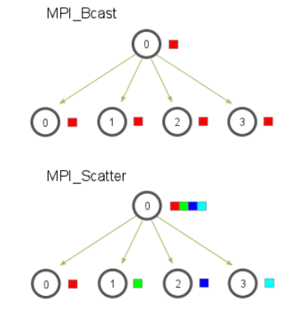
Scatter vs Broadcast
The primary difference between MPI_Bcast and MPI_Scatter that MPI_Bcast sends the same piece of data to all processes while MPI_Scatter sends chunks of an array to different processes.
MPI_Scatter takes an array of elements and distributes the elements in the order of process rank.
The first element (in red) goes to process zero, the second element (in green) goes to process one, and so on.
Although the source process (process zero) contains the entire array of data

Slide 37
Gather
The gather operation is performed in MPI using the MPI_Gather function.
int MPI_Gather(void *sendbuf, int sendcount, MPI_Datatype senddatatype, void *recvbuf, int recvcount, MPI_Datatype recvdatatype, int target, MPI_Comm comm)
Each process, including the target process, sends the data stored in the array sendbuf to the target process.
As a result, if p is the number of processors in the comm , the target process receives a total of p buffers.

Slide 38
Gather
The data is stored in the array recvbuf of the target process, in a rank order.
The data sent by each process must be of the same size and type.
That is, MPI_Gather must be called with the sendcount and senddatatype arguments having the same values at each process.

Slide 39
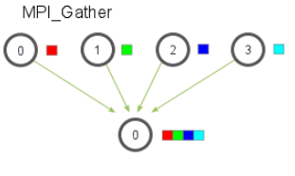
Gather
MPI_Gather is the inverse of MPI_Scatter.
Instead of spreading elements from one process to many processes, MPI_Gather takes elements from many processes and gathers them to one single process.
The elements are ordered by the rank of the process from which they were received.
This routine is highly useful to many parallel algorithms, such as parallel sorting and searching.

Slide 40
Task(s)
Generate a random array of numbers on the root process (process 0).
Scatter the numbers to all processes, giving each process an equal amount of numbers.
Each process computes the average of their subset of the numbers.
Gather all averages to the root process. The root process then computes the average of these numbers to get the final average.
The root process should also display the maximum among local averages.
Write a parallel MPI program to calculate the wordcount in a large text file (containing more that 2K words).

Slide 41
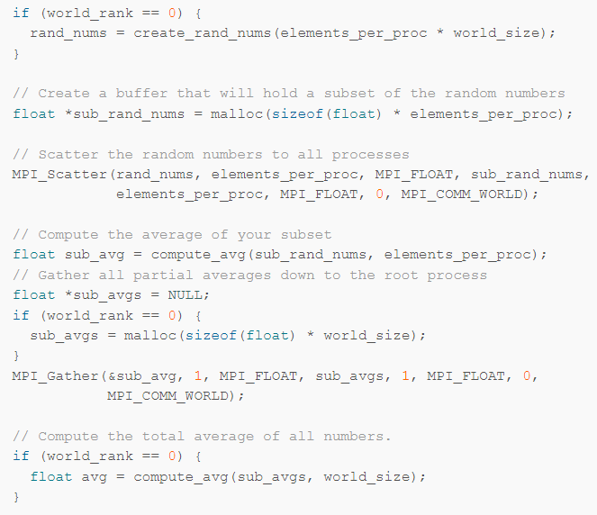

Slide 42
MPI also provides the MPI_Allgather function in which the data are gathered to all the processes and not only at the target process.
int MPI_Allgather(void *sendbuf, int sendcount, MPI_Datatype senddatatype, void *recvbuf, int recvcount, MPI_Datatype recvdatatype, MPI_Comm comm)
The meanings of the various parameters are similar to those for MPI_Gather ; however, each process must now supply a recvbuf array that will store the gathered data.

Slide 43
All-to-All Personalized Communication
In all-to-all personalized communication, each node (process) sends a distinct message of size m to every other node.
Each node sends different messages to different nodes, unlike all-to-all broadcast, in which each node sends the same message to all other nodes.
All-to-all personalized communication is also known as total exchange.
This operation is used in a variety of parallel algorithms such as fast Fourier transform, matrix transpose, sample sort, and some parallel database join operations.

Slide 44
The all-to-all personalized communication operation is performed in MPI by using the MPI_Alltoall function.
int MPI_Alltoall(void *sendbuf, int sendcount, MPI_Datatype senddatatype, void *recvbuf, int recvcount, MPI_Datatype recvdatatype, MPI_Comm comm)
Each process sends a different portion of the sendbuf array to each other process, including itself.

Slide 45
Task
For every group communication function, explain two algorithms/problems/systems which utilize them.

Slide 46
Overlapping Communication with Computation
The MPI programs we developed so far used blocking send and receive operations whenever they needed to perform point-to-point communication.
Recall that a blocking send operation remains blocked until the message has been copied out of the send buffer.
Similarly, a blocking receive operation returns only after the message has been received and copied into the receive buffer.

Slide 47
Non-Blocking Communication Operations
In order to overlap communication with computation, MPI provides a pair of functions for performing non-blocking send and receive operations.
These functions are MPI_Isend and MPI_Irecv.
MPI_Isend starts a send operation but does not complete, that is, it returns before the data is copied out of the buffer.
Similarly, MPI_Irecv starts a receive operation but returns before the data has been received and copied into the buffer.

Slide 48
The calling sequence of MPI_Isend is:
int MPI_Isend(void *buf, int count, MPI_Datatype datatype, int dest, int tag, MPI_Comm comm, MPI_Request *request)
The calling sequence of MPI_Irecv is:
int MPI_Irecv(void *buf, int count, MPI_Datatype datatype, int source, int tag, MPI_Comm comm, MPI_Request *request)

Slide 49
However, at a later point in the program, a process that has started a non-blocking send or receive operation must make sure that this operation has completed before it proceeds with it computations.
This is because a process that has started a non-blocking send operation may want to overwrite the buffer that stores the data that are being sent, or a process that has started a non-blocking receive operation may want to use the data it requested.

Slide 50
MPI_Test and MPI_Wait
To check the completion of non-blocking send and receive operations, MPI provides a pair of functions MPI_Test and MPI_Wait.
MPI_Test tests whether or not a non-blocking operation has finished.
MPI_Wait waits (i.e., gets blocked) until a non-blocking operation actually finishes.

Slide 51
Note that these functions have similar arguments as the blocking send and receive functions. The main difference is that they take an additional argument request.
MPI_Isend and MPI_Irecv functions allocate a request object and return a pointer to it in the request variable.
This request object is used as an argument in the MPI_Test and MPI_Wait functions to identify the operation whose status we want to query or to wait for its completion.
Note that the MPI_Irecv function does not take a status argument similar to the blocking receive function, but the status information associated with the receive operation is returned by the MPI_Test and MPI_Wait functions.

Slide 52
int MPI_Test(MPI_Request *request, int *flag, MPI_Status *status)
int MPI_Wait(MPI_Request *request, MPI_Status *status)
MPI_Test tests whether or not the non-blocking send or receive operation identified by its request has finished. It returns flag = {true} (non-zero value in C) if it completed, otherwise it returns {false} (a zero value in C).
In the case that the non-blocking operation has finished, the request object pointed to by request is de-allocated and request is set to MPI_REQUEST_NULL. Also the status object is set to contain information about the operation.

Slide 53
The MPI_Wait function blocks until the non-blocking operation identified by request completes.
In that case it de-allocates the request object, sets it to MPI_REQUEST_NULL, and returns information about the completed operation in the status object.

